Slide 1
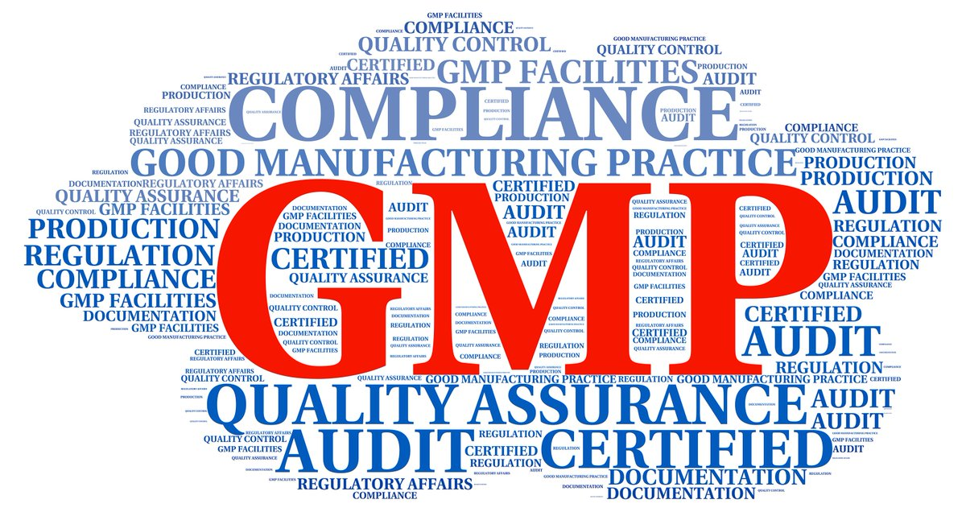

Slide 2
What is GMP
Definition:
GMP is a system ensuring that products are consistently produced and controlled according to quality standards.
It is designed to minimize the risk involved in any pharmaceutical production.
Why GMP important
Poor quality medicines are not only a health hazards but aware of money for both government and individual consumers.
Pharmaceutical company has the responsibility to ensure safe and sufficient use of medicines.

Slide 3
Main 5 components of GMP?
People:
All people involved in making a drug have clear role and responsibility
Products:
All the process must go testing, quality before distribution to consumer.
Process:
Process should be properly documented , clear and distributed to employee.
Procedures:
Standard method should be followed.
Premises:
Premises and equipment must be properly maintained and clear.

Slide 4
Principles:
Create standard operating procedures.
Implement procedures and processes.
Document procedures and processes.
Validate the effectiveness of SOPs.
Design and use working system.
Prevent contamination through cleanliness.
Conduct GMP audits regularly.

Slide 5
Guidelines:
Buildings and facilities
Equipment
Personnel
Raw materials
Production
Laboratory controls
Records
Labeling
Complaints
Other

Slide 6
SOP:
Definition:
Pharmaceutical Standard Operating Procedure (SOP) is a tested, verified, approved, and documented way of executing operations that form the pharmaceutical industry's basis. It provides step-by-step guidance for the personnel to perform a specific process.
An SOP is a procedure specific to your operation that describes the activities necessary to complete tasks in accordance with industry regulations, provincial laws or even just your own standards for running your business.

Slide 7
Concept of SOP:
There are some fundamental steps you have to follow to create a SOP:
Purpose:
Reason for writing SOPs.
Scope:
Processes , equipment, model, polices
Roles and responsibility:
Department head , executive of the department know there rules and responsibility.
Process overview:
Add a flowchart
Procedure:
Give short operating procedure
Abbreviation:
Used in SOP
Distribution:
Provide a list of all the department to which the said sop.
Review history:

Slide 8
Steps to creating SOP
STEP 1 – Develop a list of processes that you believe need SOP creation. ...
STEP 2 – Plan the process for developing and managing SOPs. ...
STEP 3 – Collect information for the content of your SOP. ...
STEP 4 – Write, review and publish your SOP.
STEP 5 - Maintaining your SOP over time.

Slide 9
Why SOP are essentials?
An integral part of the successful quality system.
Plants effectiveness and efficacy.
Regulatory requirement.
To ensure that production operation are perform consistently to maintain quality control of process and products.
To ensure that no failure are occur in any process.

Slide 10


